Slide 1

Note: The data and information in this document is reflective of a hypothetical situation and client. This document is to be used for KPMG Virtual Internship purposes only.
Sprocket Central Pty Ltd
Data analytics approach

Slide 2
Note: The data and information in this document is reflective of a hypothetical situation and client. This document is to be used for KPMG Virtual Internship purposes only.
Agenda
Introduction
Data Exploration
Model Development
Interpretation

Slide 3
Note: The data and information in this document is reflective of a hypothetical situation and client. This document is to be used for KPMG Virtual Internship purposes only.
Introduction
customers analysis
Age distributions
Number of bike purchases in 3 years / percentages purchases
Job industry category.
Wealth segments
Number of cars own on each states

Slide 4
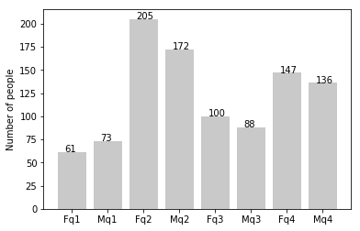
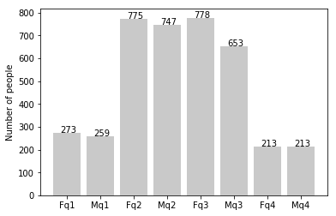
Note: The data and information in this document is reflective of a hypothetical situation and client. This document is to be used for KPMG Virtual Internship purposes only.
Data Exploration
new
Customers’ age distribution
As you can see, the majority of our new customers are between the ages of 25 and 48.
Customers between the ages of 48 and 59 show significant percentage reductions.
In terms of percentages, there is a modest increase in the number of customers who are above 59.
It looks like the percentages of under 25 years old not really change.
old

Slide 5
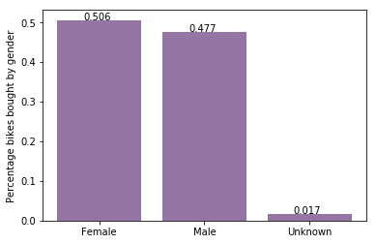
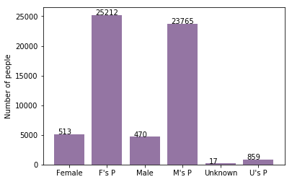
Note: The data and information in this document is reflective of a hypothetical situation and client. This document is to be used for KPMG Virtual Internship purposes only.
Model Development
Bike purchases last 3 years
As we can see, the majority of our new customers—50.6% of whom made purchases totaling 25,212 bikes—were women.
Male contributed to 47.7% purchases with 23,765 bikes
So we should focus on advertises on Female customers than Male customers

Slide 6
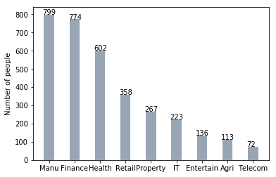
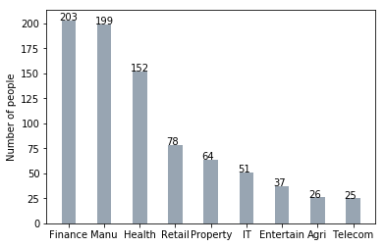
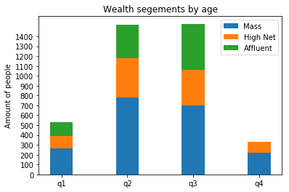
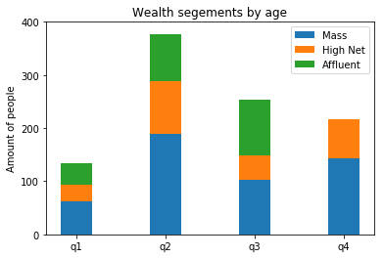
Note: The data and information in this document is reflective of a hypothetical situation and client. This document is to be used for KPMG Virtual Internship purposes only.
Interpretation
Job industry category
Most of our new clients come from the finance and manufacturing sectors. customers are still on top 2.
The rest industries is still same
Wealth segments
Most of our new customers come from the finance and manufacturing sectors..
After that, we should focus on High Net Customer.
Then Affluent Customers but mostly second and third quadrant

Slide 7
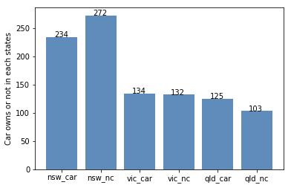
Note: The data and information in this document is reflective of a hypothetical situation and client. This document is to be used for KPMG Virtual Internship purposes only.
Interpretation
Numbers of cars owned
Given that a greater proportion of consumers in NSW do not own vehicles than do, NSW should be given priority.
Customers who own cars are more numerous in VIC and QLD than those who don't, but we can attempt to make it so that those who do buy bikes.

Slide 8
Note: The data and information in this document is reflective of a hypothetical situation and client. This document is to be used for KPMG Virtual Internship purposes only.
Thank you

